Slide 1
Navigating the Main Data Page

Slide 2
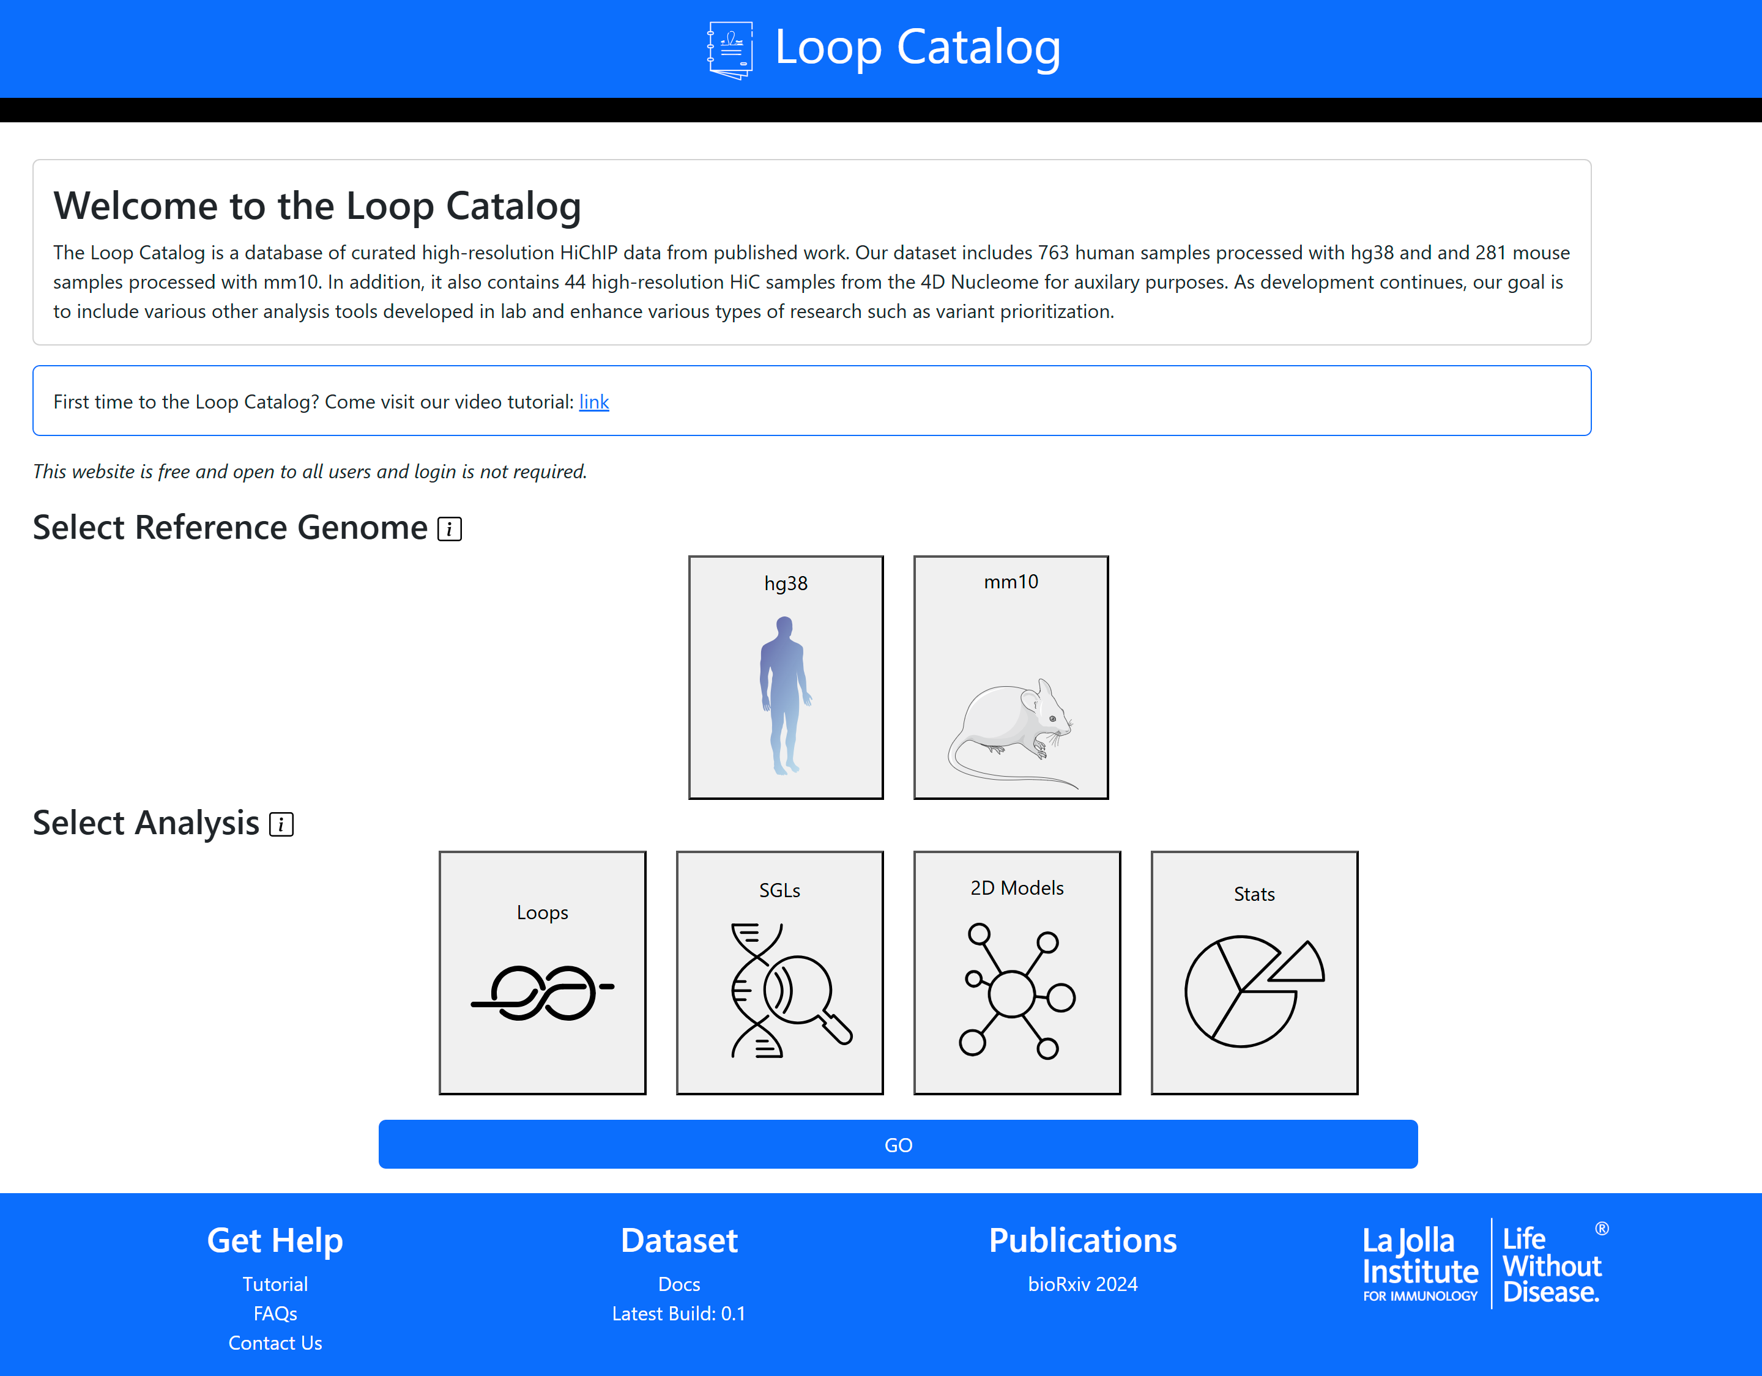
Welcome to the Loop Catalog

Slide 3
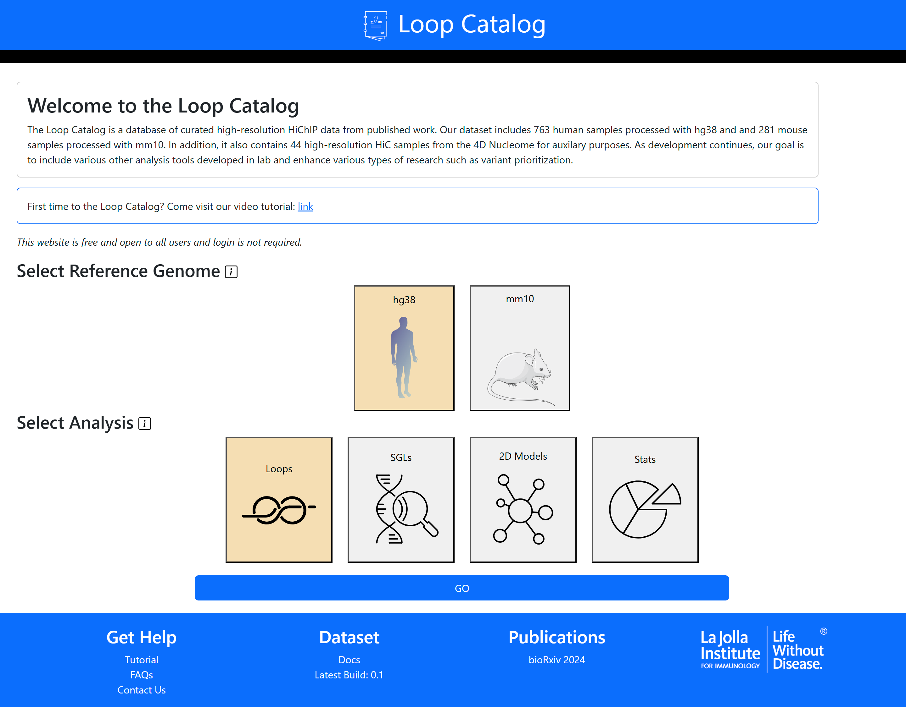
Select a Reference Genome
Select an Analysis
Click Go

Slide 4
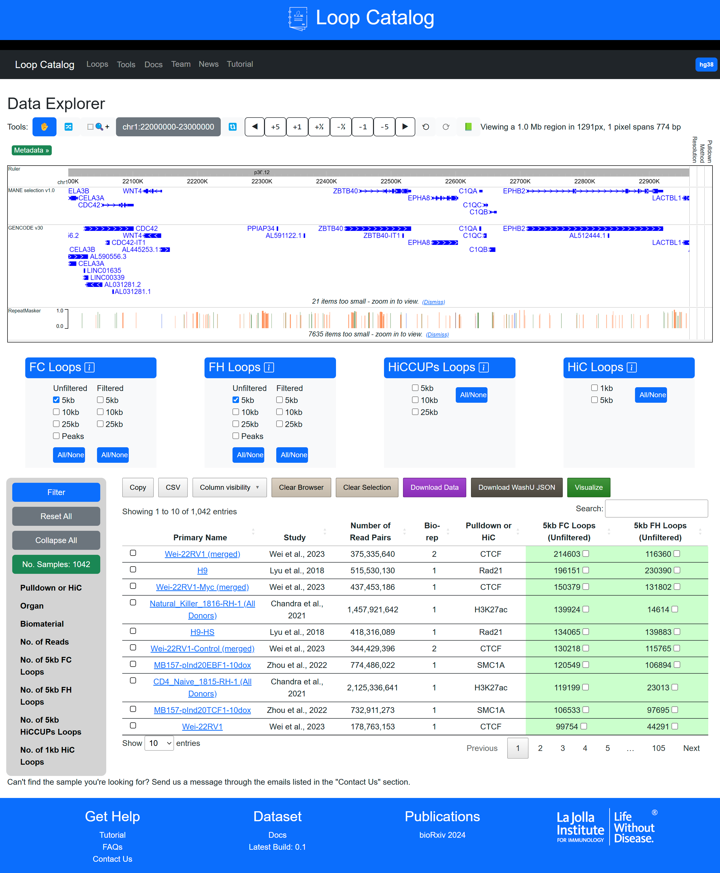
Welcome to the main data/loop page

Slide 5
WashU Epigenome Embedding
Loop Submenu
Interactive buttons
Filtering Menu
Main Data Page

Slide 6
Submenu for FC Loops with both Unfiltered and Filtered Loops
Similar submenus for
FH, HiCCUPs and HiC loops
Toggle buttons to select all unfiltered or filtered options

Slide 7
Filtering at the loop calling and sample levels
2) Click Filter
Helper functions
Displays current number of samples
1) Select filtering criteria

Slide 8
Hide/show columns from table
Clear the browser
Clear the sample selection
Download tracks from selected samples
Download WashU hub for selected samples
Copy table to clipboard or save to CSV
Visualize selected samples
Table with HiChIP/HiC samples & loop calls
Select samples for interactive functions
Click on sample link to visit sample summary page

Slide 9
Navigation buttons for the WashU Browser
Meta data for each track including resolution, method and pulldown
Two gene tracks. One derived from the MANE selection and the other from GENCODE v30

Slide 10
Understanding the Single Sample Page

Slide 11
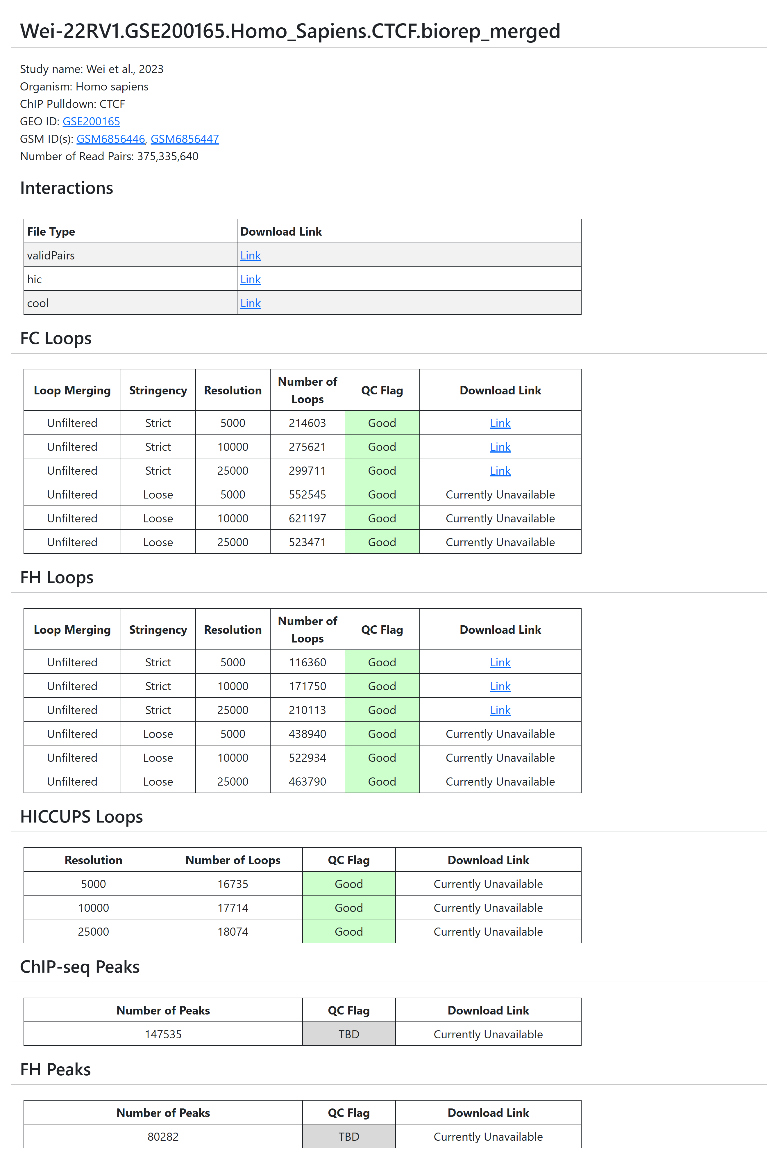
Standard Sample Name
Study & General Information
Links to download interaction level data
Table for FC Loops and links to download the raw loop files
Basic Single Sample Page
Table for FH Loops and links to download the raw loop files
Table for HiCCUPS Loops and links to download the raw loop files
Table for ChIP-seq Peaks and links to download the raw peak files
Table for FH Peaks and links to download the raw peak files

Slide 12
cytoscapeJS powered network
Table of community detection results
Single Sample Pages with the Community Detection Module
Filtering buttons for table above

Slide 13
Accessing SGL Results

Slide 14
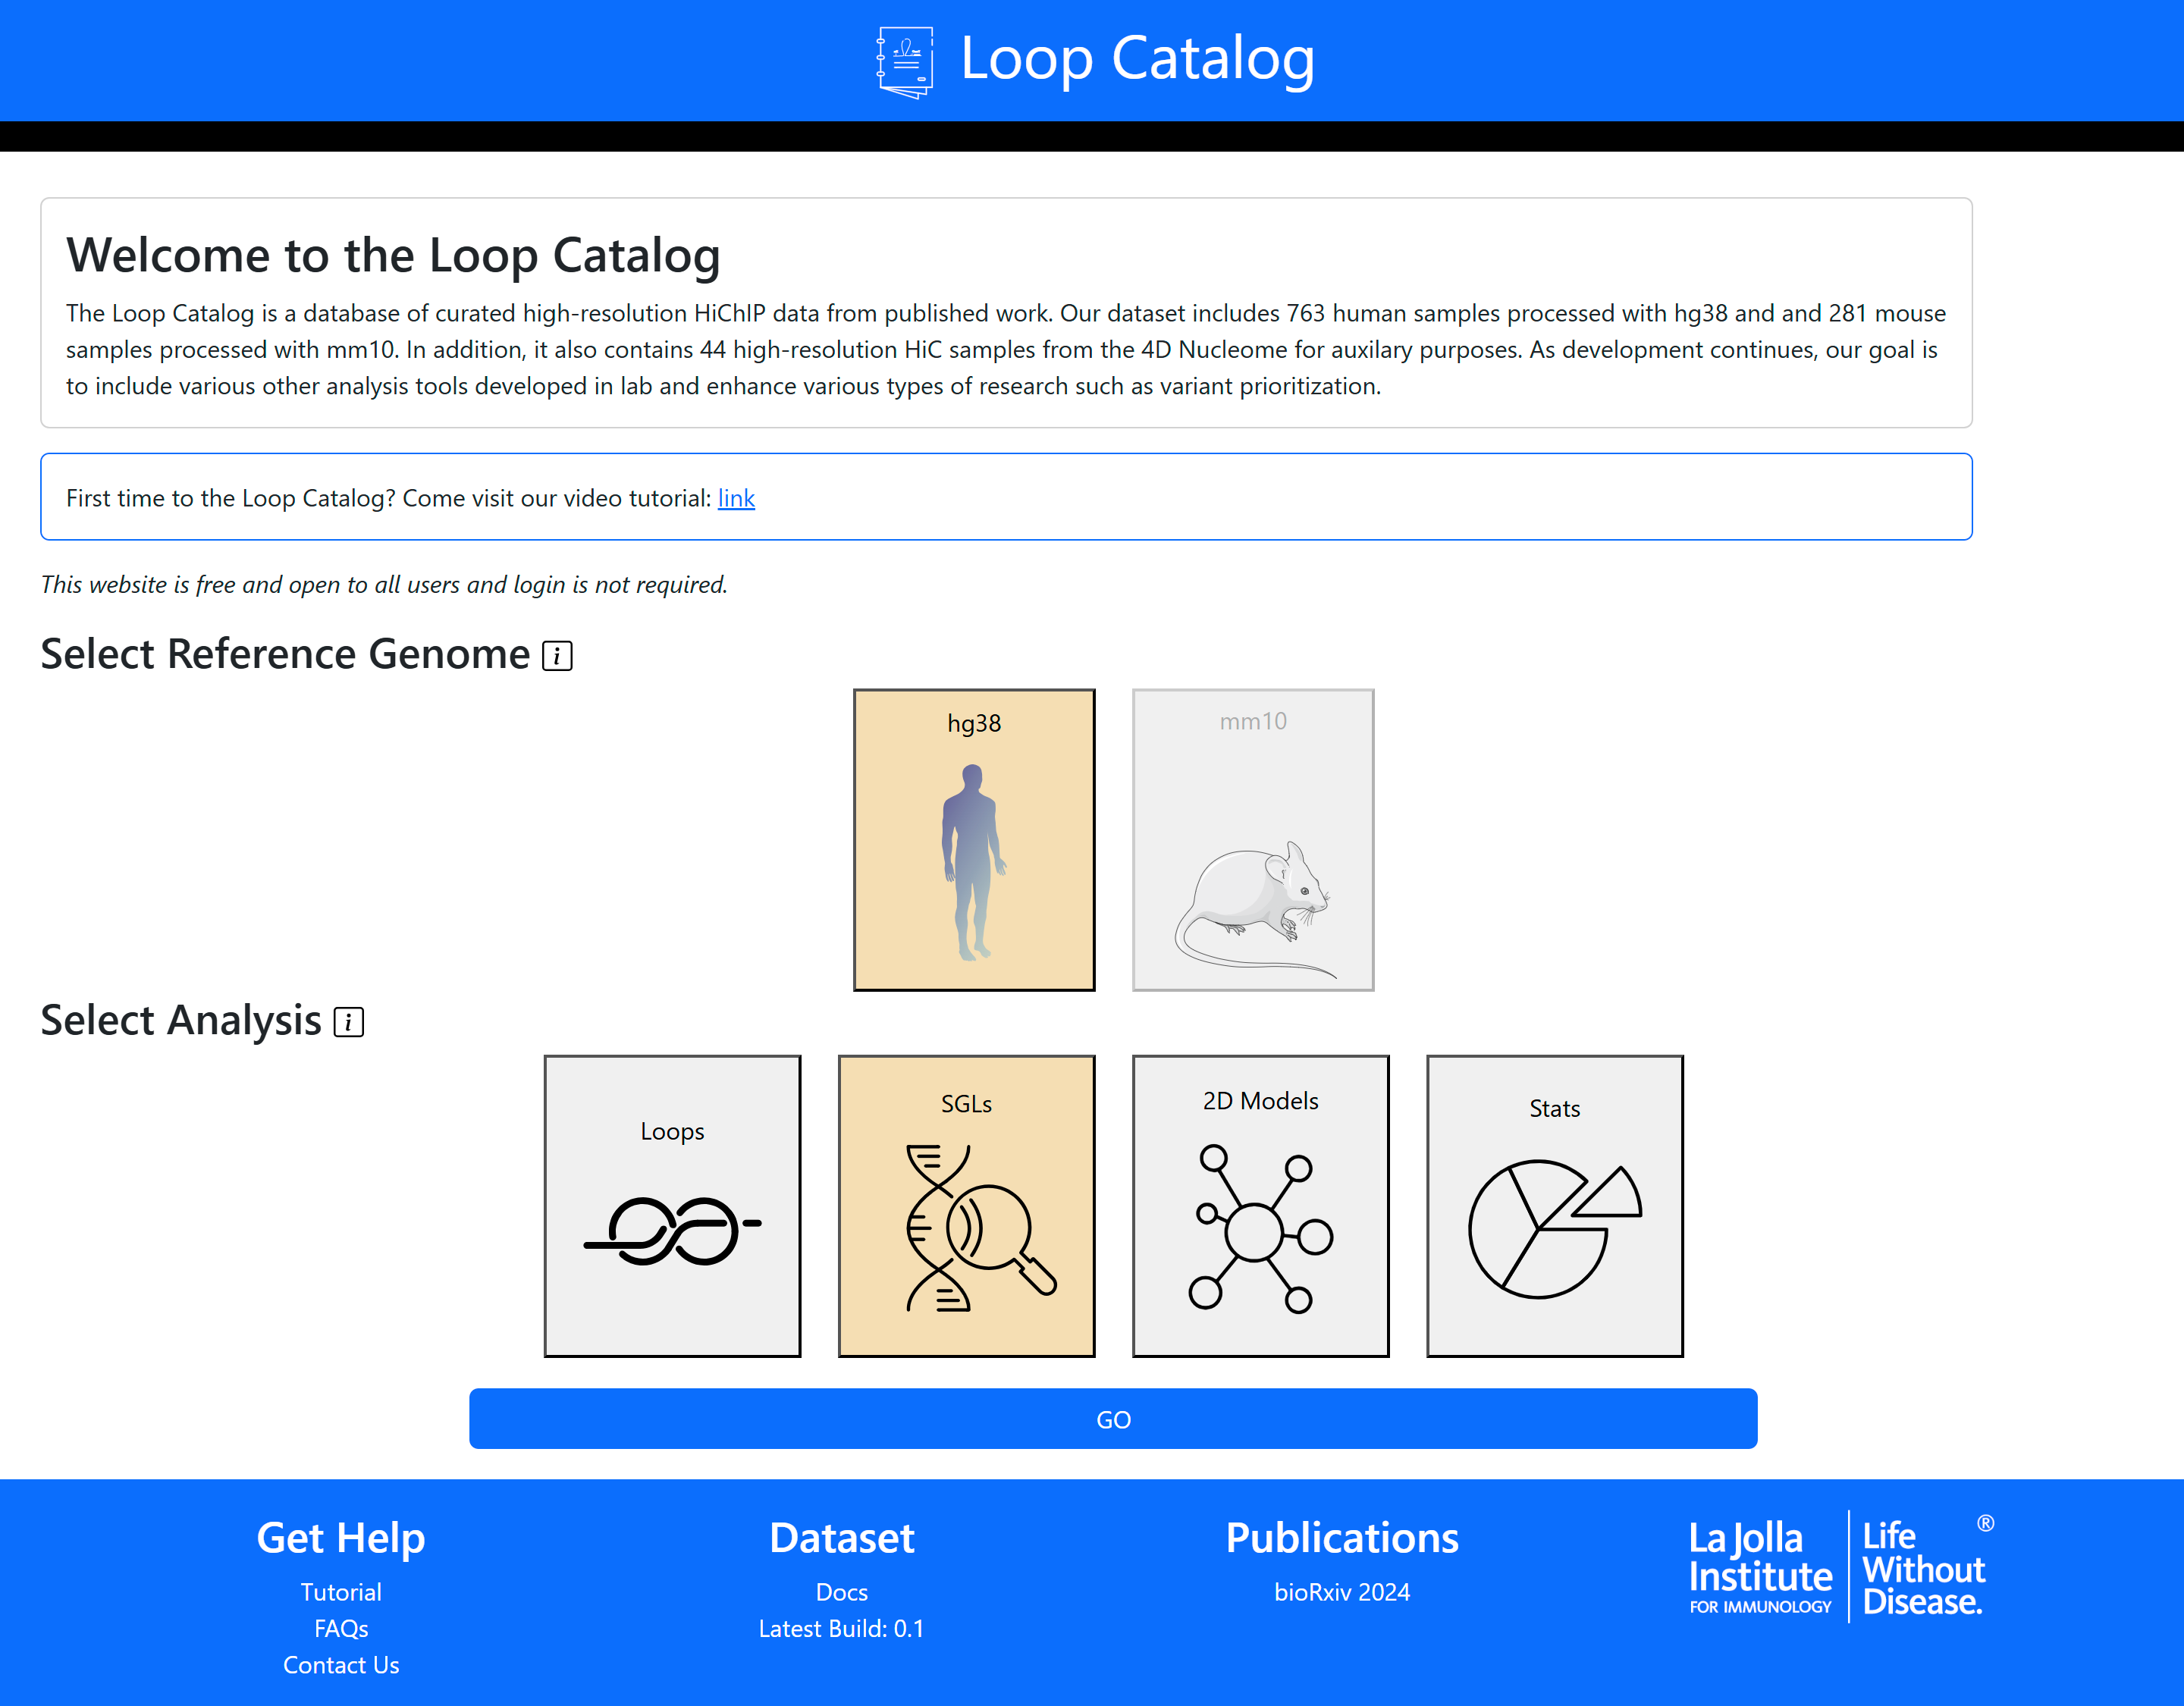
Access via the main page

Slide 15
Alternatively, access from the Navigation Bar after a previous query
Tools → GWAS SGLs

Slide 16
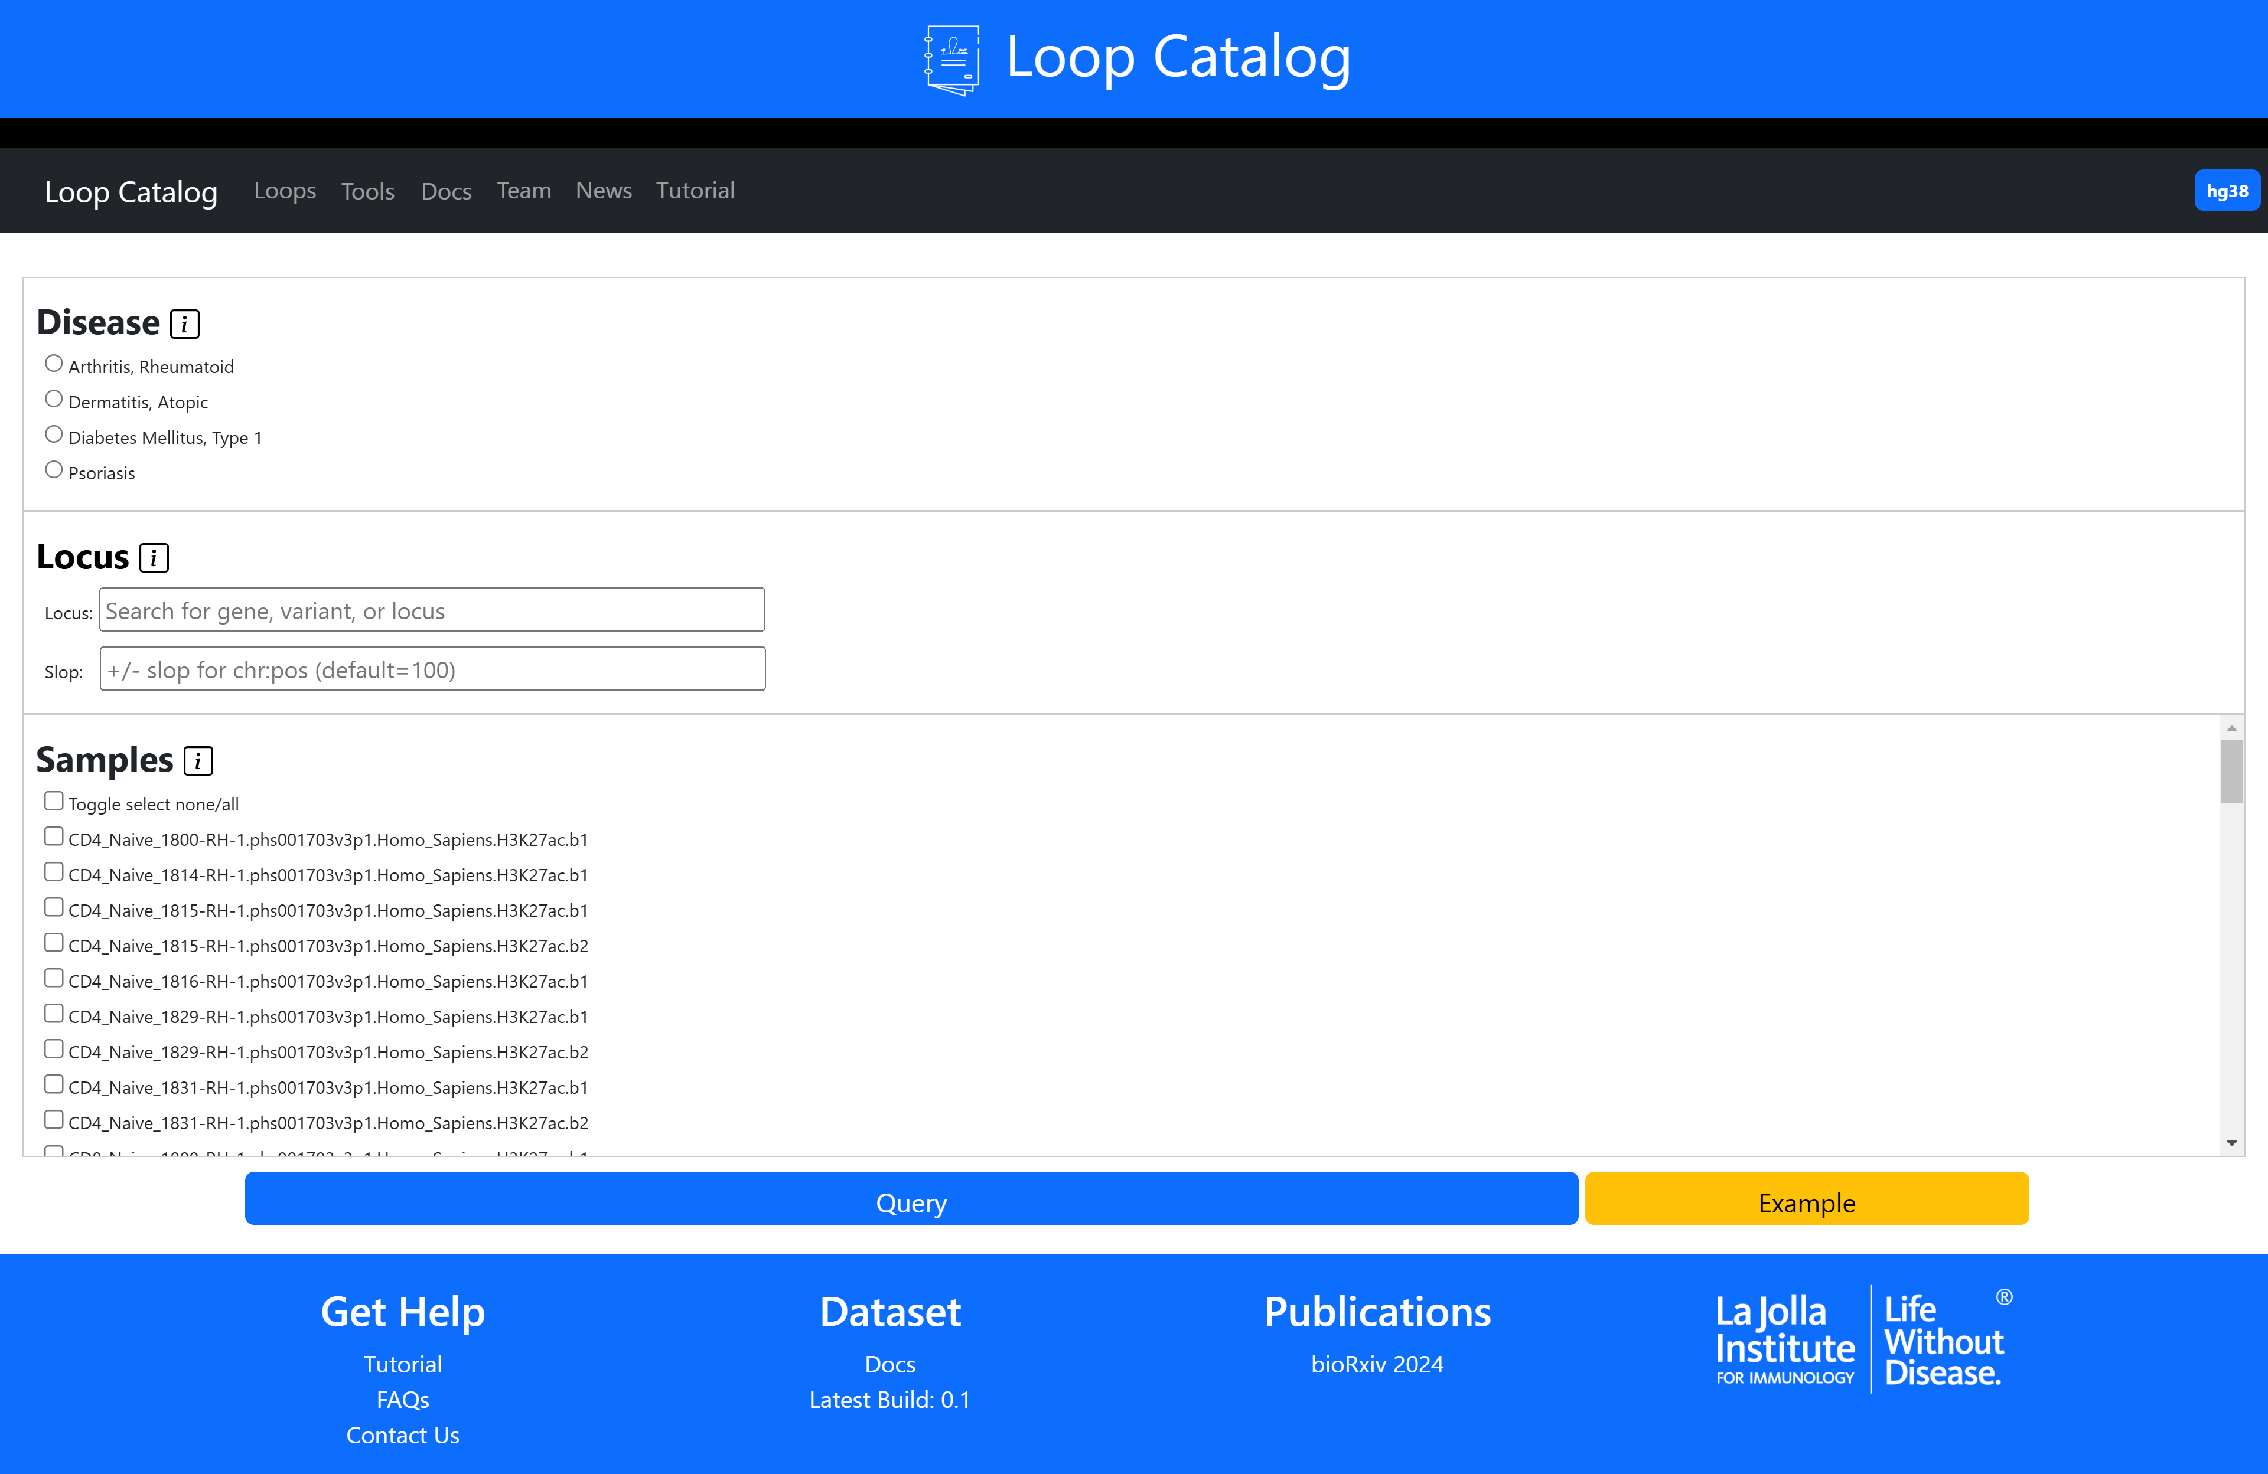
Select disease
Select locus
Select samples

Slide 17
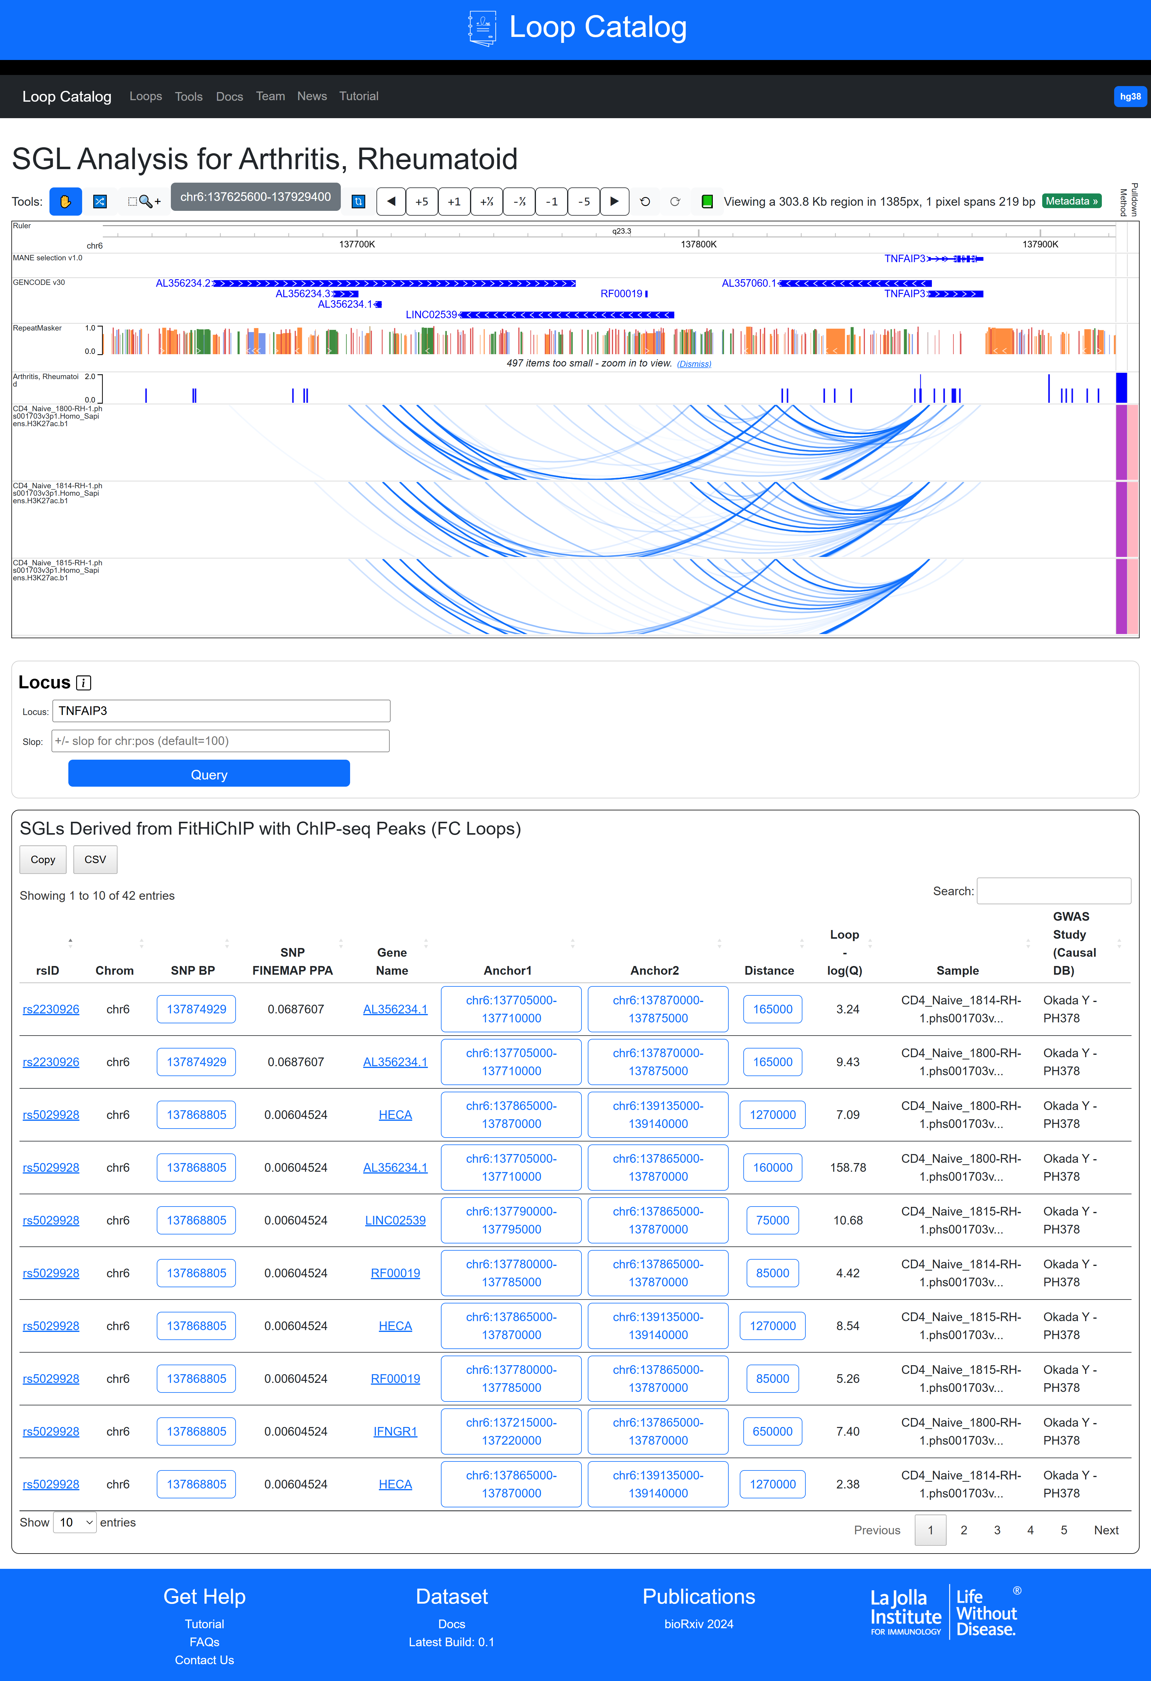
WashU Browser
Re-select locus
Table of SGL results

Slide 18
SNP nav button
Anchor 1 Navigation
Anchor 2 Navigation
Loop Navigation
Each row represents an SGL
Anchor1 and Anchor2 contain the bins corresponding to the left and right sides of a loop
Distance is measured as the start of Anchor2 minus the start of Anchor1
Loop –log10(Q) stores the significance value derived from FitHiChIP)
GWAS Study (CAUSALdb) contains the publication authors followed by the CAUSALdb ID
Link to dbSNP
Link to OpenTargets

Slide 19
Accessing 2D Embeddings

Slide 20
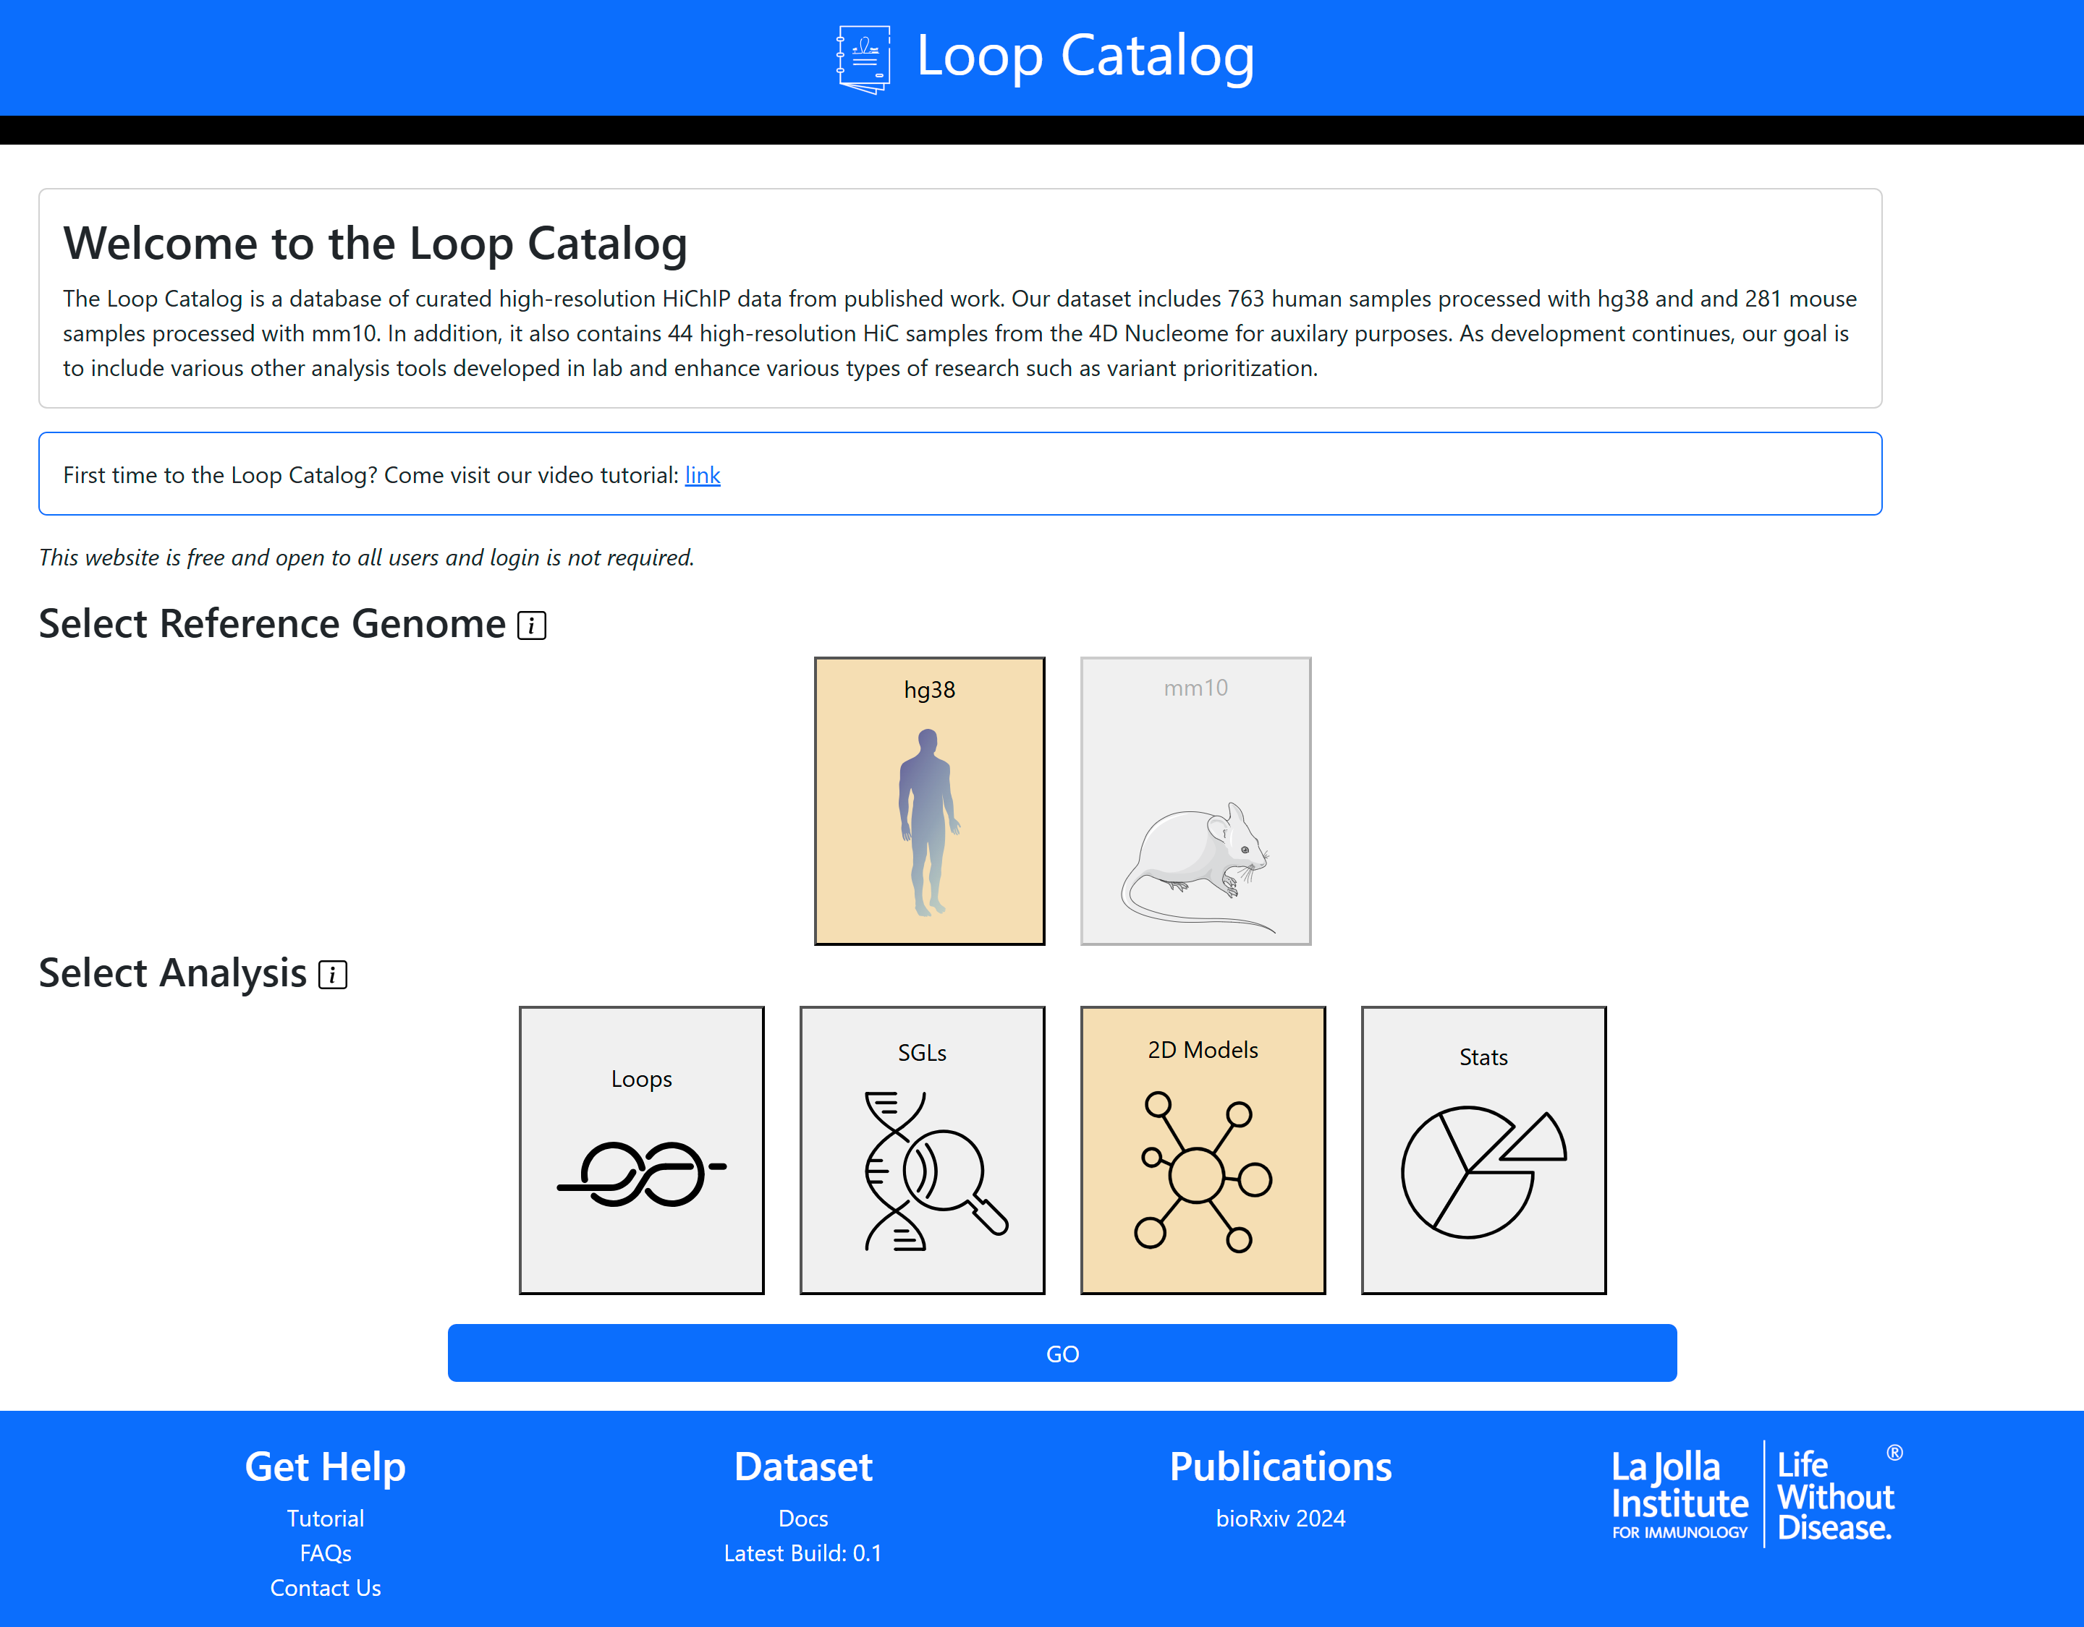
Alternative access: Nav bar → Tools → 2D Embeddings

Slide 21
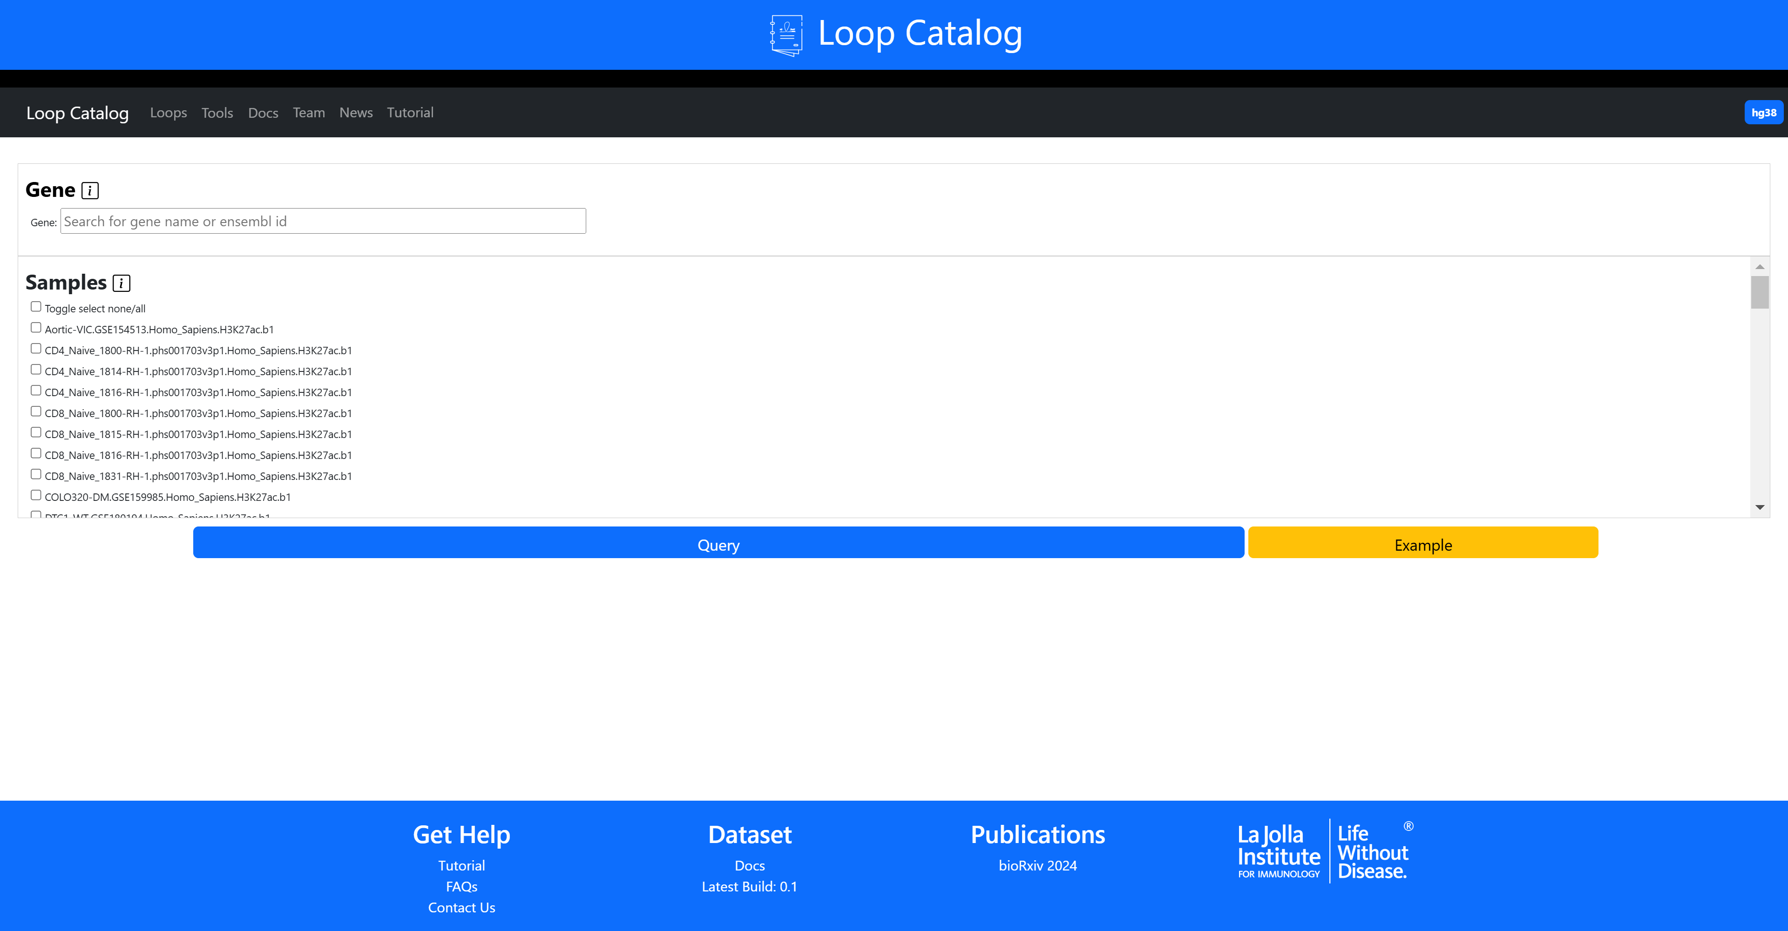
Select Gene
Select Samples

Slide 22
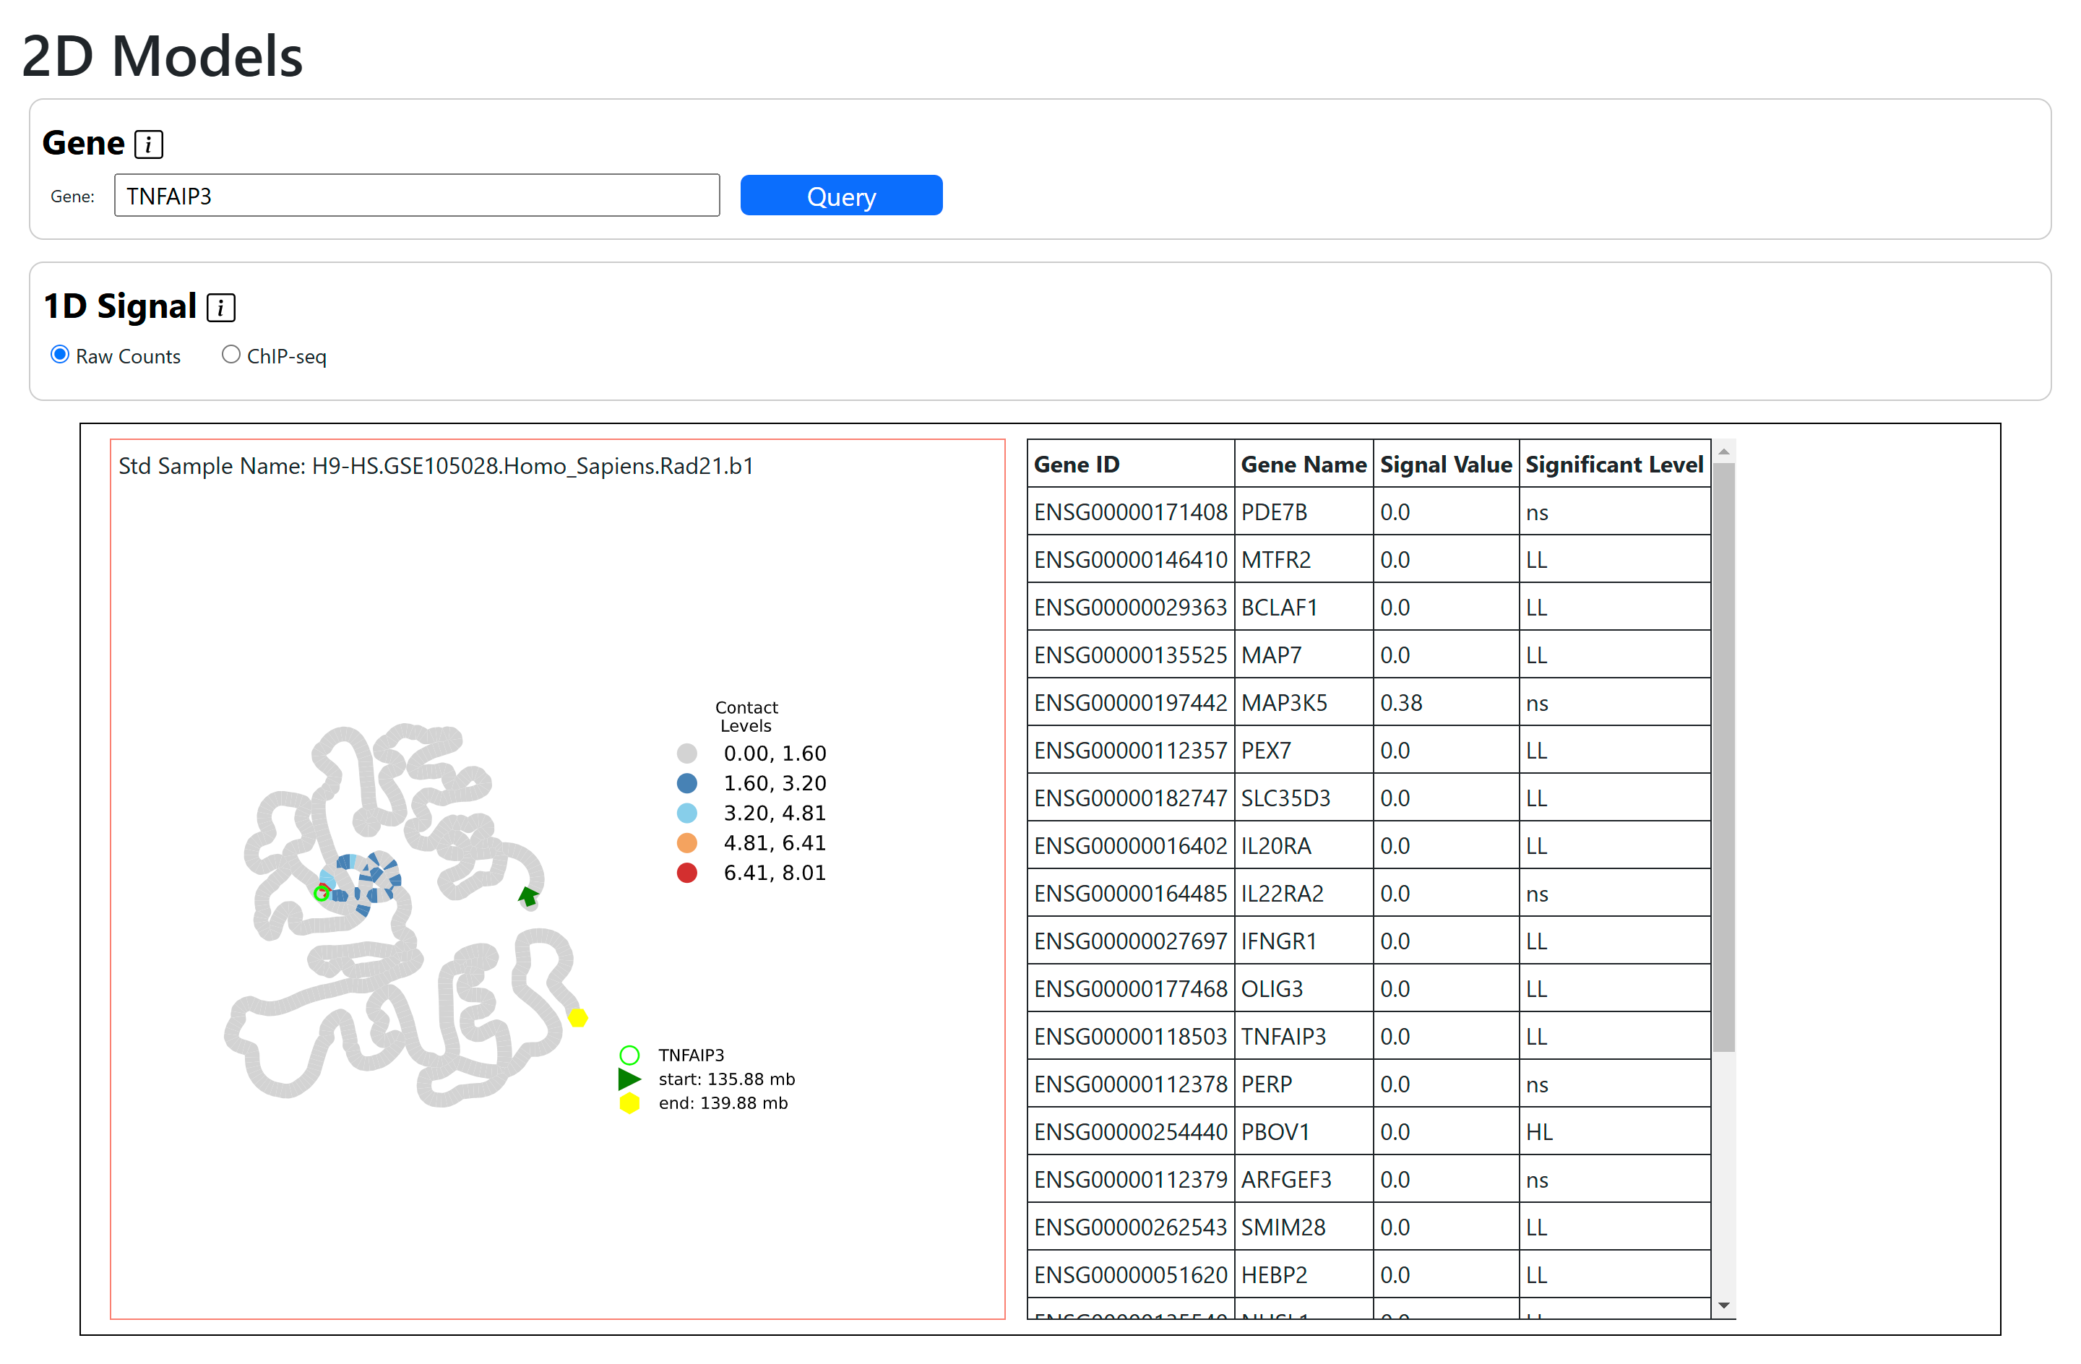
2D embedding model with overlap of raw counts (sum of contacts for a given bin within this subregion)
Quickly query a new gene with the same sample set
Select the overlapping 1D signal
Results table where each row is a gene with its signal value and (local Moran’s) significance level
Visualization of the 2D embedding model

Slide 23
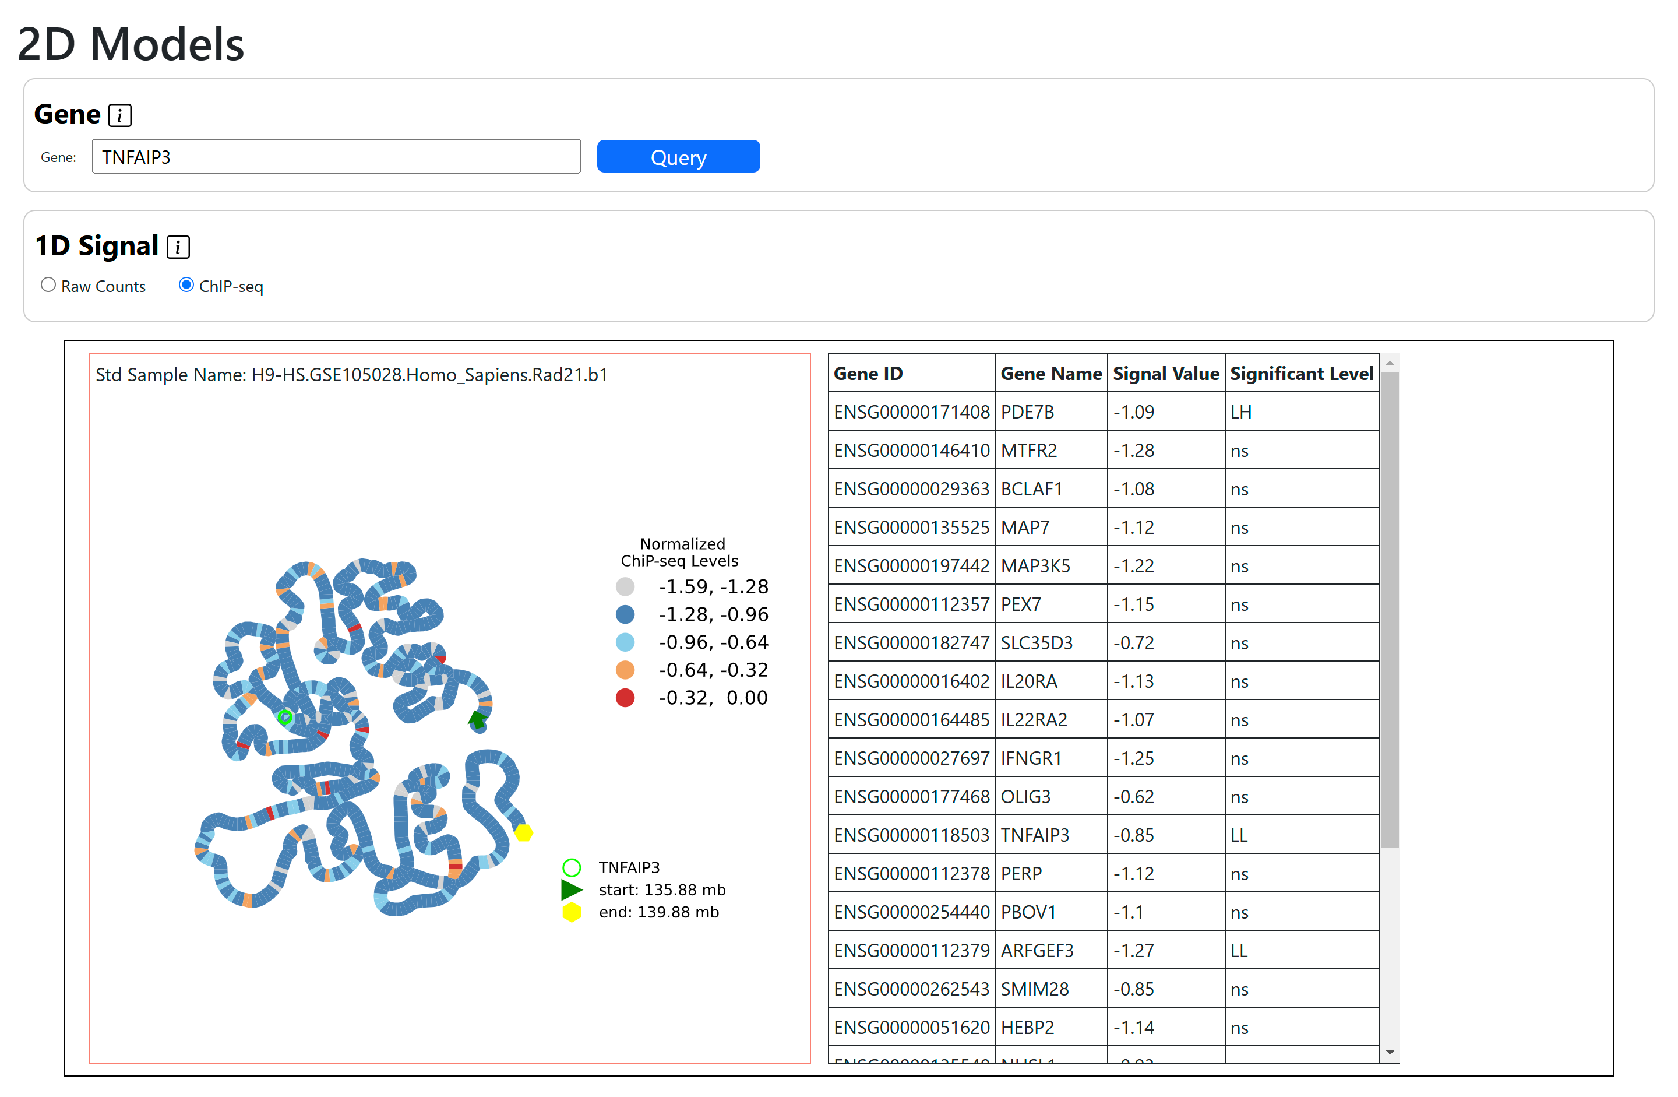
2D embedding model with overlap of ChIP-seq signal
Colored based on ChIP-seq
Results are now based on local Moran’s I using ChIP-seq signal values
Same 2D structure

Slide 24
Other: Accessing Basic Statistics

Slide 25
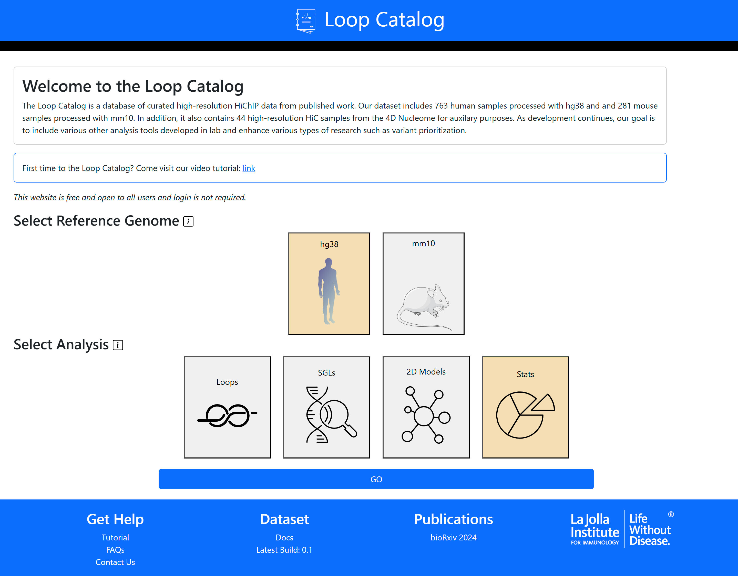
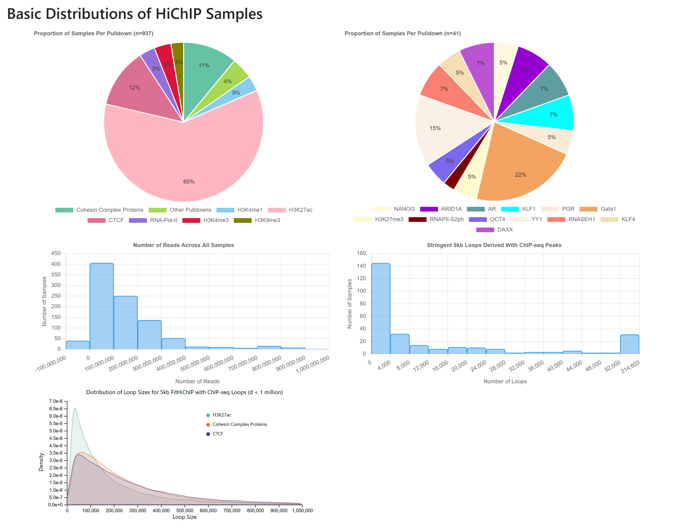
Access Basic Statistics
Select and GO!
Alternative access: Nav bar → Tools → Statistics
Breakdown of pulldowns, number of reads, number of loops and loop size

Slide 26
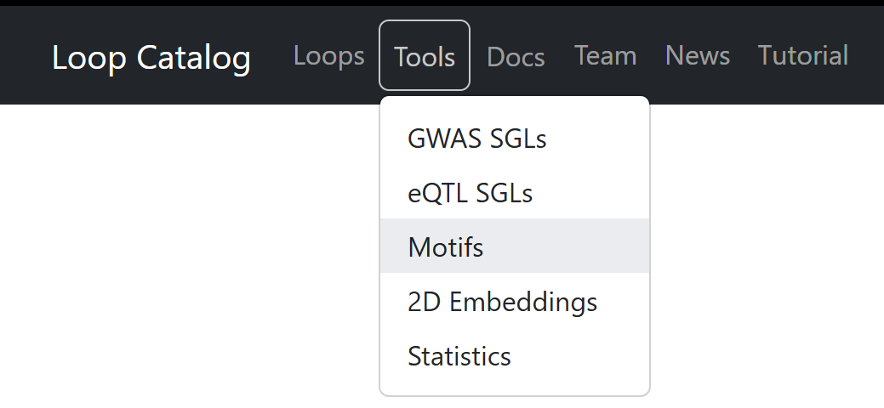
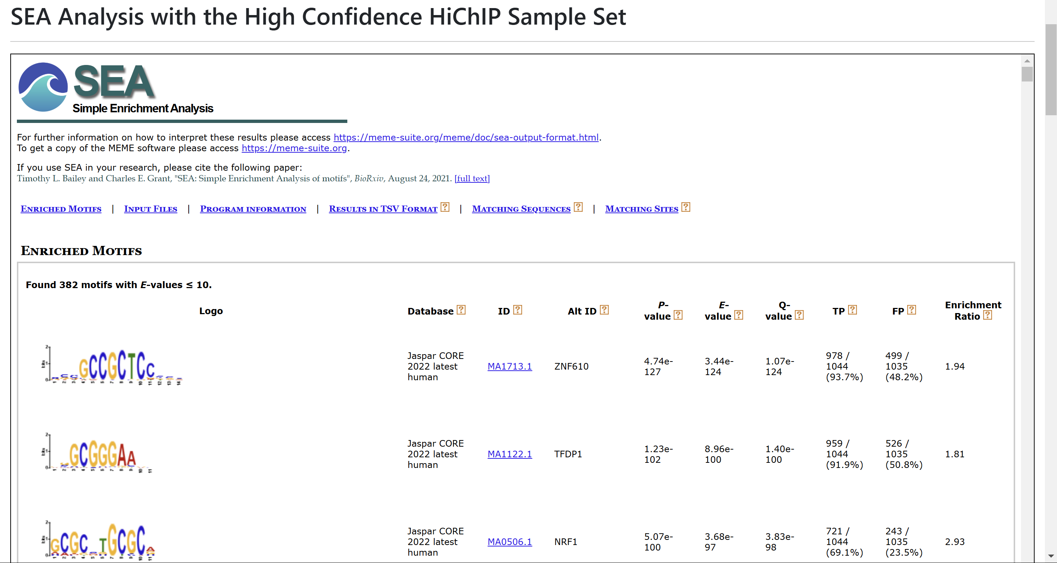
Accessing 1D Motif Results
Alternative access: Nav bar → Tools → Motifs
Access from Tools
Results for each of the SEA analysis using different subsets of the High Confidence HiChIP Sample Set, this includes:
All samples
Immune only
Non-immune only
CTCF only

